Slide 1





CLASS CAPTAIN
AFOS – GIBT – UCC

Slide 2



US Police Shootings Group 3
EXPLORATORY DATA ANALYSIS

Slide 3
The police shooting were all acts of racism
HYPOTHESIS

Slide 4
What type of ammunition was mostly used? In what manner were the victims killed? What race was prevalently killed/shot? What gender was prevalently shot/killed? Did any of the victims try to run away from the scene ? Did an of the victims show signs of mental illness?
QUESTIONS

Slide 5
VISUALISATIONS

Slide 6
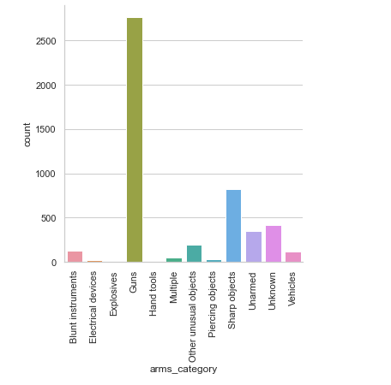
WHAT TYPE OF AMUNITION WAS MOSTLY USED?

Slide 7
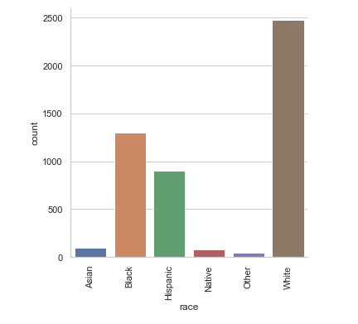
WHAT RACE WAS PREVALENTLY KILLED/SHOT?

Slide 8
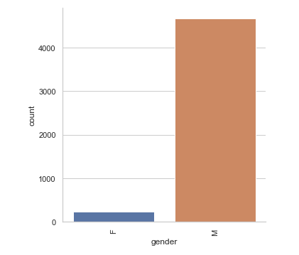
WHAT GENDER WAS PREVALENTLY KILLED/SHOT?

Slide 9
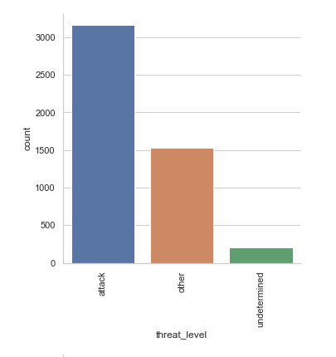
DID ANY OF THE VICTIMS SHOW SIGNS OF ATTACK?

Slide 10
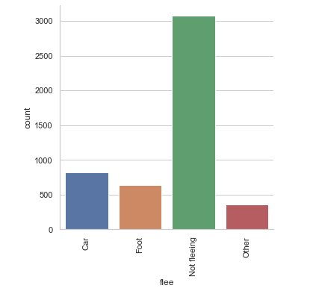
DID ANY OF THE VICTIMS TRY TO RUN AWAY FROM THE SCENE?

Slide 11

INSIGHTS

Slide 12
Most of the policemen had no body camera on in 88% of the cases. This raises a lot of questions as to their intentions.
Was it intentional to hide the incident?
Were the said policemen off duty?
Were their body cameras working hours, days prior to the incident?

Slide 13
56% of the killings were executed with guns.
Does this suggest an execution of the act from a safe distance that would not have the perpetrator hurt or compromised in any regard?
17% of the killings were done using sharp objects
Does this suggest a struggle between the victims and the police?
What could have caused this struggle?
Which party initiated it? Was it the police or the victim’s doing?

Slide 14
Only 23% of the victims showed signs of mental illness.
This implies 77% of them had knowledge and a clear enough mind on how to hold a reasonable interaction with an officer on duty
What went south?

Slide 15
51% and 27% of the killings involved victims of the white and black race respectively.
Does this point to the long existing strife between the latter and the former?

Slide 16
95% of the killings involved males rather than females
Does this suggest that the male gender is more susceptible to physical violence?

Slide 17
These among other insights from the data point to the huge possibility of racism not being the underlying cause of these shootings or killings since most whites were killed than the blacks in the US
SUMMARY

Slide 18
We would need to get more data on the shootings in US so as to be able to determine the actual cause
RECOMMENDATION

Slide 19
From our hypothesis, racism is not the actual cause of shootings in the US given the little information we have on the data
CONCLUSION

Slide 20

THANK YOU

